Slide 1
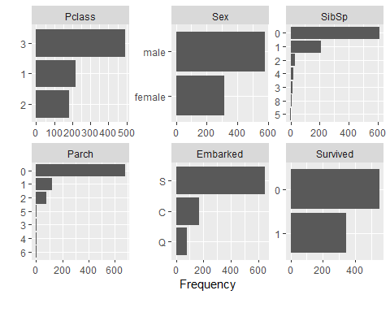

Sample Statistics from Titanic Study
Outcome – survival (yes=1 or no=0,)
SibSp - number of siblings or spouse a passenger had
Parch - Number of parents/children/nanny aboard the Titanic

Slide 2
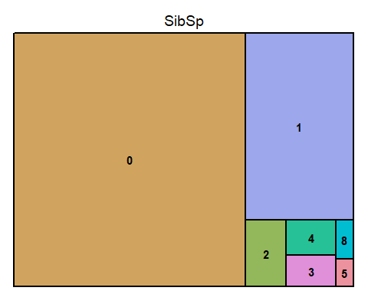
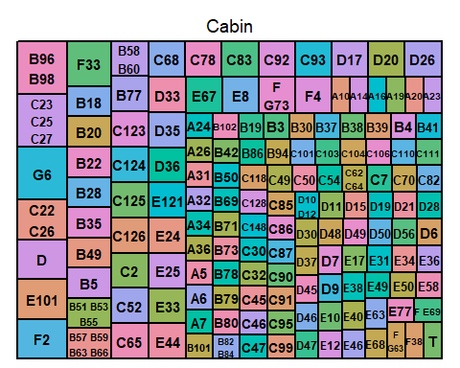
Machine Learning Tools - Titanic Study
SibSp - how many siblings and spouses a passenger had
Cabin – cabin number
From – Machine Learning with the Titanic Dataset by Benedikt Droste - Towards Data Science

Slide 3
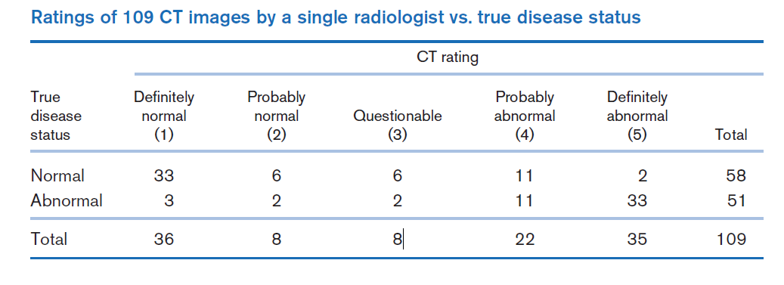
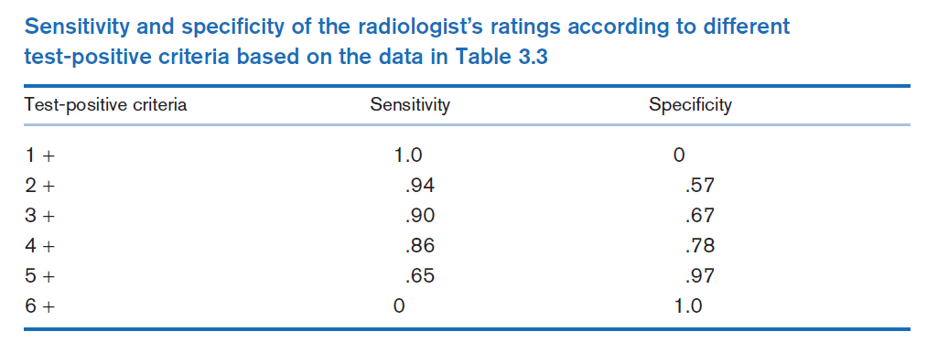
ROC Curve – from Rosner Fundamentals of Biostatistics, 5th edition

Slide 4
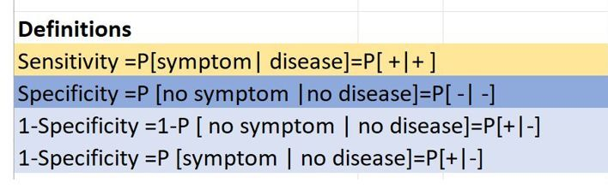
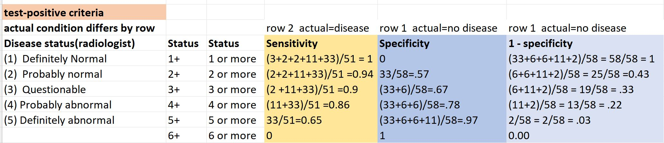
Computing Sensitivity and Specificity
Roc curve is a plot of the sensitivity versus one minus specificity of a screening test.
Curve points correspond to cutoff points used to designate test positive.

Slide 5

The End

